Slide 1
SQL

Slide 2
Relating Multiple Tables

Slide 3
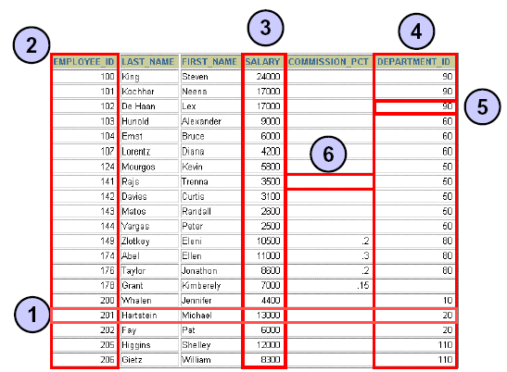
Relational Database Terminology
Column
FK
PK
Field
NULL
Row

Slide 4
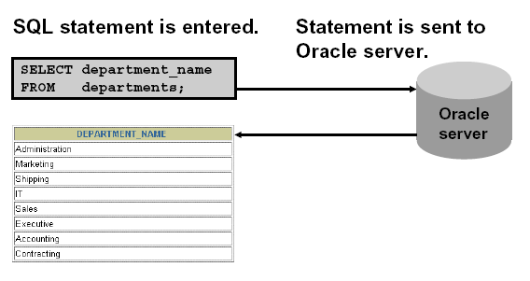
Communicating with an RBMS Using SQL

Slide 5
SQL Statements
Data Manipulation Language
SELECT
INSERT
UPDATE
DELETE
Data Definition Language
CREATE
ALTER
DROP
RENAME
TRUNCATE
Data Control Language
GRANT
REVOKE
Transaction Control
COMMIT
ROLLBACK
SAVEPOINT

Slide 6
DML - INSERT
INSERT INTO table [(column [, column...])]
VALUES (value [, value...]);
Insert into MK
Values (‘410100001’,’SBD’3);
Insert into MK(sks,nm_mk)
Values (2,’Pancasila’);
Insert into MK
Select kd_mk,nm_mk,sks From MK1;
Insert into MK(kd_mk,sks,nm_mk)
Select * From MK1;

Slide 7
DML - UPDATE
UPDATE table
SET column = value [, column = value, ...]
[WHERE condition];
Update MK
Set nm_mk = ‘SBD 1’
Where kd_mk = ‘410100001’;
Update MK
Set sks = 4
Where kd_mk like ‘41010%’ ;
Update MK
Set sks = (Select sks From MK
Where kd_mk = ‘410100005’)
Where nm_mk like ‘Akuntansi%’

Slide 8
DML - DELETE
DELETE [FROM] table
[WHERE condition];
Delete From MK
Where sks = 4;
Delete MK
Where nm_mk = ‘SBD’ and kd_mk like ‘4%’;
Delete MK
Where sks = (Select sks From MK
Where kd_mk = ‘390100003’)
and kd_mk like ‘41010%’

Slide 9
Capabilities of SQL SELECT Statements
Selection
Projection
Table 1
Table 1
Join
Table 1
Table 2

Slide 10
Basic SELECT Statement
SELECT [DISTINCT] {*, column [alias],...}
FROM table;
SELECT identifies what columns.
FROM identifies which table.

Slide 11
SELECT

Slide 12
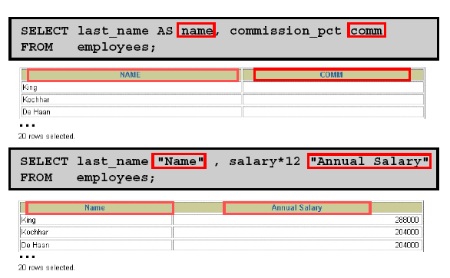
ALIASES

Slide 13
LITERAL

Slide 14
Limiting Rows Selected
Restrict the rows returned by using the WHERE clause.
The WHERE clause follows the FROM clause.
SELECT [DISTINCT] {*| column [alias], ...}
FROM table
[WHERE condition(s)]
[ORDER BY {column, expr, alias} [ASC|DESC]];

Slide 15
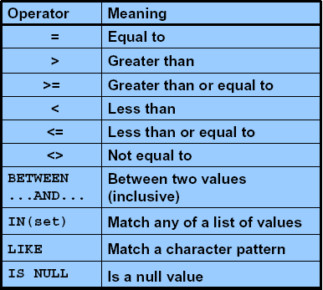
Comparison Conditions

Slide 16
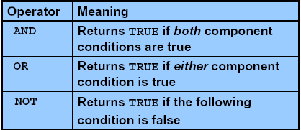
Logical Conditions

Slide 17
Using the WHERE Clause
SQL> SELECT ename, job, deptno
2 FROM emp
3 WHERE job='CLERK';
ENAME JOB DEPTNO
---------- --------- ---------
JAMES CLERK 30
SMITH CLERK 20
ADAMS CLERK 20
MILLER CLERK 10

Slide 18
Rules of Precedence
SQL> SELECT ename, job, sal
2 FROM emp
3 WHERE job='SALESMAN'
4 OR job='PRESIDENT'
5 AND sal>1500;
ENAME JOB SAL
---------- --------- ---------
KING PRESIDENT 5000
MARTIN SALESMAN 1250
ALLEN SALESMAN 1600
TURNER SALESMAN 1500
WARD SALESMAN 1250

Slide 19
Rules of Precedence
Use parentheses to force priority.
SQL> SELECT ename, job, sal
2 FROM emp
3 WHERE (job='SALESMAN'
4 OR job='PRESIDENT')
5 AND sal>1500;
ENAME JOB SAL
---------- --------- ---------
KING PRESIDENT 5000
ALLEN SALESMAN 1600

Slide 20
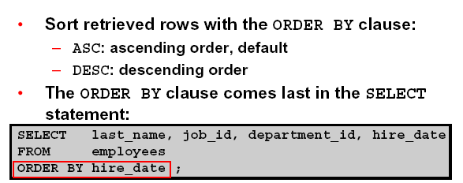
Using the ORDER BY Clause

Slide 21
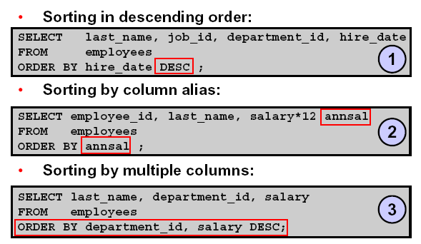
Sorting

Slide 22
Two Types of SQL Functions
Functions
Single-row
functions
Multiple-row
functions

Slide 23
Single-Row Functions
Character
General
Number
Single-row
functions
Conversion
Date

Slide 24
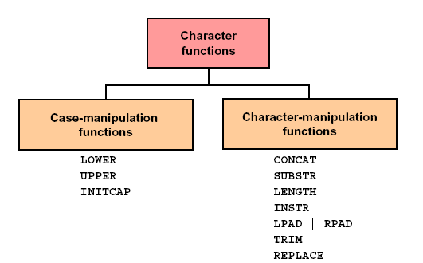
Character Functions

Slide 25
Case Conversion Functions
Convert case for character strings
Function
Result
LOWER('SQL Course')
UPPER('SQL Course')
INITCAP('SQL Course')
sql course
SQL COURSE
Sql Course

Slide 26
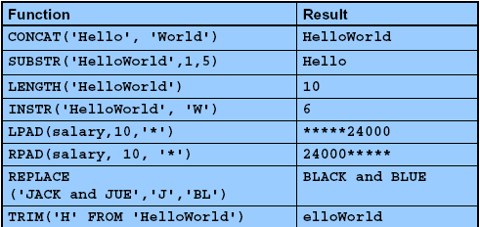
Character Manipulation Functions
Manipulate character strings

Slide 27
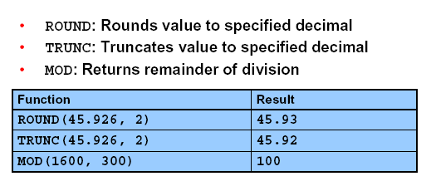
Number Function

Slide 28
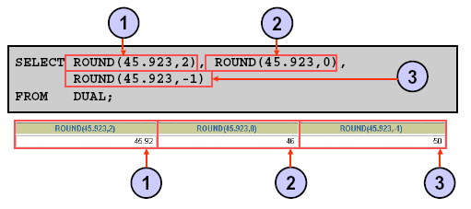
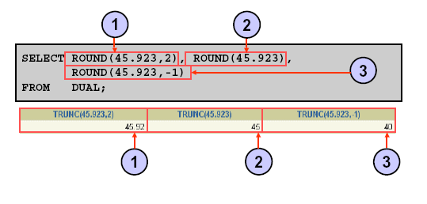

Slide 29
Using Date Functions
MONTHS_BETWEEN ('01-SEP-95','11-JAN-94')
19.6774194
ADD_MONTHS ('11-JAN-94',6)
'11-JUL-94'
NEXT_DAY ('01-SEP-95','FRIDAY')
'08-SEP-95'
LAST_DAY('01-SEP-95')
'30-SEP-95'

Slide 30
Using Date Functions
ROUND('25-JUL-95','MONTH') 01-AUG-95
ROUND('25-JUL-95','YEAR') 01-JAN-96
TRUNC('25-JUL-95','MONTH') 01-JUL-95
TRUNC('25-JUL-95','YEAR') 01-JAN-95

Slide 31
Explicit Datatype Conversion
TO_NUMBER
TO_DATE
NUMBER
CHARACTER
DATE
TO_CHAR
TO_CHAR

Slide 32
DECODE Function
Facilitates conditional inquiries by doing the work of a CASE or IF-THEN-ELSE statement
DECODE(col/expression, search1, result1
[, search2, result2,...,]
[, default])

Slide 33
Using Group Functions
Group functions operate on sets of rows to give one result per group.
SELECT [column,] group_function(column)
FROM table
[WHERE condition]
[GROUP BY column]
HAVING group_condition]
[ORDER BY column];
AVG
COUNT
MAX
MIN
STDDEV
SUM
VARIANCE

Slide 34
What Is a Join?
Use a join to query data from more than one table.
Write the join condition in the WHERE clause.
Prefix the column name with the table name when the same column name appears in more than one table.
SELECT table1.column, table2.column
FROM table1, table2
WHERE table1.column1 = table2.column2;

Slide 35
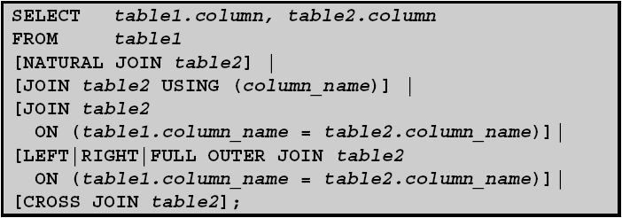
Types of Joins
Equijoin
Non-equijoin
Outer join
Self join

Slide 36
Subqueries
SELECT select_list
FROM table
WHERE expr operator
(SELECT select_list
FROM table);
The subquery (inner query) executes once before the main query.
The result of the subquery is used by the main query (outer query).

Slide 37
Using a Subquery in the FROM Clause
SQL> SELECT a.ename, a.sal, a.deptno, b.salavg
2 FROM emp a, (SELECT deptno, avg(sal) salavg
3 FROM emp
4 GROUP BY deptno) b
5 WHERE a.deptno = b.deptno
6 AND a.sal > b.salavg;
ENAME SAL DEPTNO SALAVG
---------- --------- --------- ----------
KING 5000 10 2916.6667
JONES 2975 20 2175
SCOTT 3000 20 2175
...
6 rows selected.

Slide 38
Creating Table
CREATE TABLE [schema.]table
(column datatype [DEFAULT expr]
[column_constraint],
...
[table_constraint][,...]);
Creating View
CREATE [OR REPLACE] [FORCE|NOFORCE] VIEW view
[(alias[, alias]...)]
AS subquery
[WITH CHECK OPTION [CONSTRAINT constraint]]
[WITH READ ONLY];

