Slide 1
Development of a Scoring Rubric to Assess the Creativity of Student-Designed Product
Maimunah Husien
Institut Aminuddin Baki, Malaysia
Email: mai_sbpigbk@yahoo.com

Slide 2
INTRODUCTION
Malaysia has placed creativity an important element in its school system
Two latest educational transformation program the KSSR - Kurikulum Standard Sekolah Rendah (Elementary School Curriculum Standard) and the SPPK – Sistem Pentaksiran Pendidikan Kebangsaan (National Educational Assessment System) have the emphasis on the subject.

Slide 3
How can Creativity be Enhanced
The NACCCE report (1999) as cited by Craft (2001) has suggested 3 key task to teach for creativity
1. Encouraging
2. Identifying
3. Fostering

Slide 4
Design Education and the Fostering of Creativity
Design activity in technological design education is one example of where creativity can be fostered.
According to Lewis (2005) - technological design which is one of the content areas of technology subject is almost ideally suited to uncovering dimensions of creative potential which remain hidden in much of the rest of the curriculum
The open-ended nature of design tasks which allow more than one right answer and more than one right method of arriving at the solution make design very suitable for the inculcation of creativity in children

Slide 5
Design Education and the Fostering of Creativity - continue
However the assessment of student design activities have not been done sufficiently. Indeed according to Lewis (2005) it is still an under developed area
Without proper assessment, the creativity achieved by student designing could not be determined, hence hindering further effort to improve it.
The student will have the impression that creativity is not valued if the creativity of their works is not being assessed

Slide 6
Functional Creativity
Functional creativity (Cropley & Cropley, 2005) emphasized on effective novelty. In this model product function is placed priory of product novelty based on the ground that a novel product is useless unless it can do what it is designed to do
This model is applicable for socially useful product as designed by the targeted group of the study

Slide 7
Functional Creativity
Functional creativity has four dimensions namely
1. Relevance and Effectiveness - Satisfying requirements in the problem statement
2. Novelty - problematization, adding to existing knowledge and developing new knowledge
3. Elegance -external and internal elegance
4. Genesis - ideas go beyond the immediate problem

Slide 8
The Instrument – First Study
The instrument developed in this study is developed based on Functional Creativity
The indicators of creativity in this instrument were sourced
1. the Creativity Solution Diagnostic Scale (Cropley and Cropley 2005).
2. literatures on criteria for design quality & design inventiveness
3. the officials document of the subject itself

Slide 9
The Instrument - continue
Originally the instrument has a total of 30 indicators
- 6 indicators for Relevance and Effectiveness
- 11 indicators for Novelty
- 7 Indicators for Elegance
- 6 indicators for Genesis
The rubric is a 5 performance level ranging from 0 to 4 with level 4 being the highest

Slide 10
The Student Designs
The designs were obtained from two schools in the state of Kedah offering Engineering Technology
30 Form 4 students of the two school were ask to design a product based on the design activity framework adopted for this study
The design task was prepared by the researcher and has been validated by six content expert and one creativity expert. It has also been pilot tested by a different set of students

Slide 11
Methodology
5 teachers from the state of Kedah, Perlis and Pulau Pinang were recruited to assess 30 student designs each
Before grading the student work the teachers were given a brief on the rubric and how to use it
They were given 2 days to finished marking the work

Slide 12
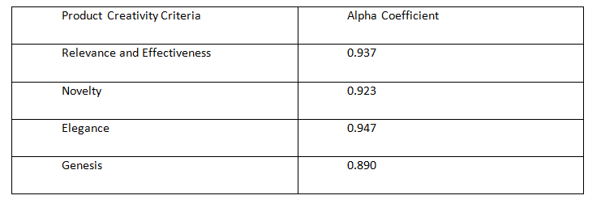
Result - Cronbach Alpha Coefficient

Slide 13
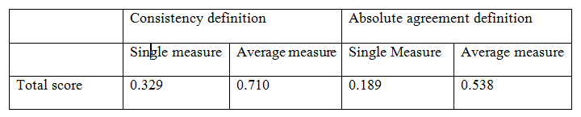
Result - Inter Rater Reliability of the Total Score

Slide 14
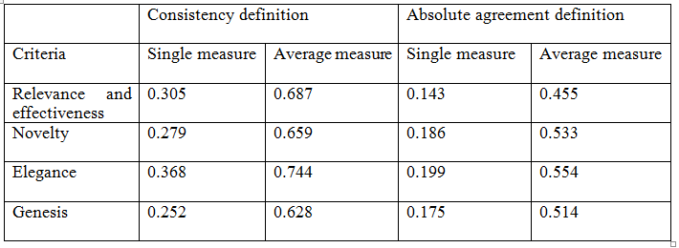
Result - Inter Rater Reliability of the Score for Each Dimension

Slide 15
The Instrument – Second Study
Based on the response given by three raters and one expert panel, few modification has been done on the rubric:
1. The number of indicators for two of the dimensions had changed
-Relevance and Effectiveness has 7 indicators
-Novelty has 11 indicators
-Elegance has 6 indicators
-Genesis has 6 indicators
2. The explanation for some of the indicators had been modified
When applicable the indicators are accompanied by criteria to make the scoring more objective

Slide 16
Methodology
10 teachers from the state of Kedah, Perlis and Pulau Pinang were recruited to score the student designs using the rubric developed in this study
Each teachers were to score the same 20 student designs. 200 set of data is obtained.
The scoring process is done within 3 to 4 hours period
Prior to doing the scoring, the teachers were given training on the rubric and how to use it
A scoring manual were also provided to assist the teachers when doing the scoring

Slide 17
Data Analysis
The thirty indicators of the Student Design Rubric were subjected to Exploratory Factor Analysis using SPSS Version 18.
The suitability of the data for EFA was first determine.
This involved the inspection on correlation coefficient from the Correlation Matrix, the value of the Kaiser Meyer-Olkin Measure of Sampling Adequacy (KMO) and the statistical significant from the Bartlett’s Test of Sphericity.
Inspection of the Correlation Matrix showed that majority of the coefficient were 0.3 and above. The KMO value was 0.922 and the statistical significant from for Bartlett’s Test of Sphericity was 0.000

Slide 18
Initial Result
The initial Principal Component Analysis conducted on the data revealed the presence of five components with eigenvalues exceeding 1, explaining 46.318%, 14.683 %, 5.983%, 4.172% and 4.098% respectively.
The five components solution explained a total of 75.253% of the variance.

Slide 19
Result of Initial Analysis
An inspection of the Scree Plot revealed a clear break after the fifth components, supporting the five components (or factors) structured of the rubric
Oblimin Rotation was then performed to aid the interpretation of the five components.

Slide 20
Result of Initial Analysis

Slide 21
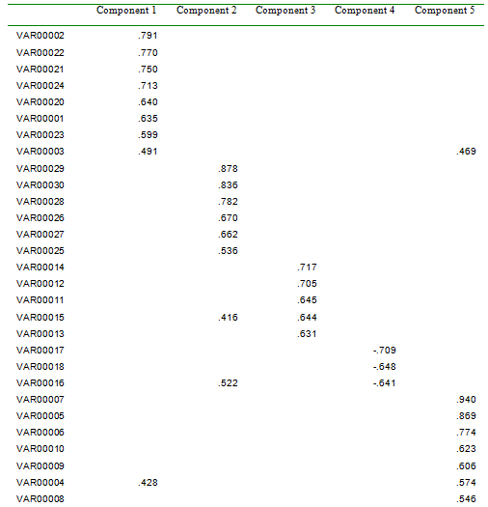
Pattern Matrix

Slide 22
Result of Initial Analysis
Few creativity indicators were found to be cross loaded namely VAR00003, VAR00015, VAR00016 and VAR00004, with value exceeding 0.40 on two components.
One indicator (VAR00019 )had a low loading value of less than 0.40

Slide 23
Further Analysis
To get a better structure, a stepwise deletion is perform to the low loading and cross loading item.
After each deletion, EFA was re-run to determine the next indicator to be deleted
This was done until no more cross loading indicator was found

Slide 24
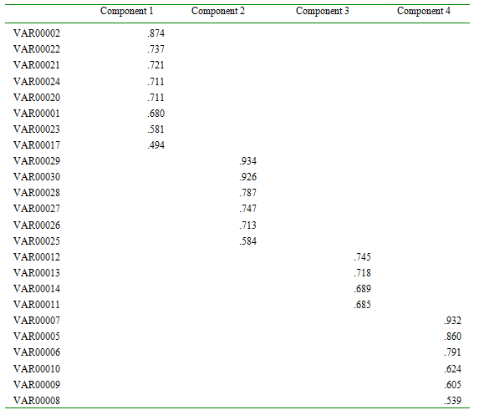
Pattern Matrix after Deletion of Indicators

Slide 25
Result after Stepwise Deletion
The Pattern Matrix shows that only 4 components is discovered with
-eight indicators in Component 1
-six indicators in Component 2
-four indicators in Component 3
-six indicators in Component 4.

Slide 26
Discussion and Conclusion
Even though there are a total of five components originally discovered, the stepwise deletion on the low loading and cross loading indicators resulted on only four components with the total of twenty four indicators
Component 2 show a clear support of Genesis dimension of Functional Creativity. All the six indicators are from the proposed dimension. It will maintain the name Genesis.
Component 3 will stick with Novelty because all the four indicators in this component are the proposed novelty indicators.

Slide 27
Discussion and Conclusion
The other two components (Component 1 and 4) shows quite a different result
Majority of the indicators for component 1 is from the Elegance dimension of the proposed rubric. Two indicator from Relevance and Effectiveness (Correctness –the solution is answer the question and performance – the solution do what it is supposed to do) is mixed with it
Component 4 is comprised of 3 indicators from Relevance and Effectiveness Dimension (Durability, Safety and Productization) and 3 indicators from Problemitization element of the Novelty Dimension (Diagnosis, Prescription and Prognosis)
New name is necessary for the two components

Slide 28
Discussion and Conclusion
Other form of data extraction or rotation technique should be tried out before the model is finalized.
Confirmatory Factor Analysis with a new set of data should also be conducted to further validate the instrument

Slide 29
Thank you

