Slide 1
Problem-Based Learning the 4 Core Areas (PBL4C): identifying & redefining values for nurturing creativity in building a new nation in Southeast Asia
Teoh Boon Tat, Warabhorn Preechaporn,
Leong Chee Kin & Fong Ho Kheong
Mathematics Education Specialists
SEAMEO RECSAM
Notes:
1

Slide 2
Introduction
Problem-Based Learning the 4 Core Areas (PBL4C) nurtures Creativity and Entrepreneurship…
PBL is a learning strategy using realistic context problems.
PBL processes (among others):
identifying the problem;
gathering the information given unique to the problem;
procuring extra information in the view of finding a solution to the problem;
generating possible solutions;
communicating, accommodating, selecting and executing the best solution, and
making a presentation of the best solution.

Slide 3
Introduction
Problem-Based Learning the 4 Core Areas (PBL4C) nurtures Creativity and Entrepreneurship…
PBL4C is a PBL model integrating the
4 Core Areas of Learning:
multi-disciplinary content knowledge,
multi-dimensional skills,
appropriate thought, &
universal harmonious values.
> in the mathematics and science classrooms.

Slide 4
Overview of a PBL4C lesson
Title: Nurturing Creativity in Building a New Island Nation in Southeast Asia
Building a new nation’s Capital City
Instruct to destruct
2D map
3D design
Evaluation
CONTEXT
PROBLEM
Scenario 1
Scenario 2
Scenario 3
Scenario 4
3-Stage Model of Contextualisation, Decontextualisation and Recontextualisation ( Holbrook & Rannikmae , 2007)

Slide 5
Context Problem
A new island the size of Penang has emerged from the South China Sea as a result of changes to the earth. You are the founders of the newest island nation in this 21st Century.
As the leaders of your nation, you are responsible as a team to plan, design and develop your beloved country making its development sustainable in all its glory for the rest of the world to model.

Slide 6
Scenario 1 - 3D design
Being the new nation’s founders, build a 3-D model of your visionary capital city for sustainable & responsible living of your beloved fellow citizens. State your reasons for having such plans.
These reasons may one day form the framework of your country’s constitution.

Slide 7
Scenario 2 - 2D map
If one of the structures you built is the size of the building block you are now in, draw a map of the capital city of your country on a piece of mahjong paper, according to scale.
Calculate the actual dimension of the other structures. Label the measurements accordingly on the map. Showcase your model city to your visiting foreign delegations.

Slide 8
Scenario 3 - Evaluation
Evaluate each other’s plan of a model country bearing in mind local & global sustainable and responsible development using the assessment form given to you.

Slide 9
Scenario 3 - Evaluation
Form 1
Capital City Evaluation A Model City for World Sustainable and Responsible Living. It is not easy to be a model city for the world to emulate. Search in detail and list down below all the great features of the city that can make the city a model for the world to follow.
Form 2
Capital City Evaluation A Model City for World Sustainable and Responsible Living. It is not easy to be a model city for the world to emulate. Search in detail and list down below all the faults and weaknesses you can find in the city model.
Practising Critical Thinking

Slide 10
Scenario 4 – Instruct to Destruct
Read the instruction carefully on the piece of paper given to you.
Follow this instruction precisely. You must make sure the city model be pushed down. Tear the map to pieces. Your Leader

Slide 11
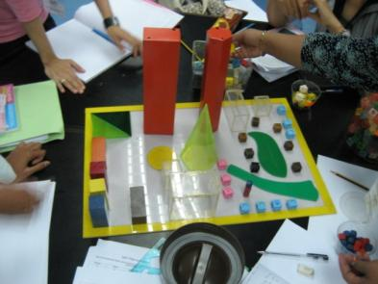
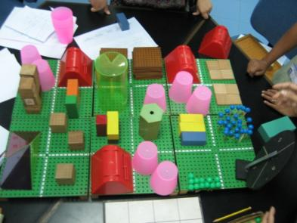
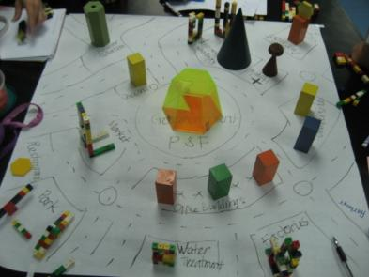
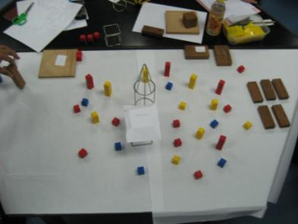
Scenario 1 – 3D Construction

Slide 12
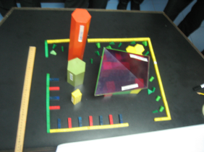
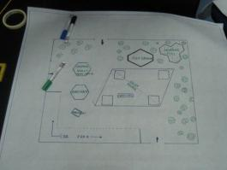
Scenario 2 – 3D to 2D map

Slide 13
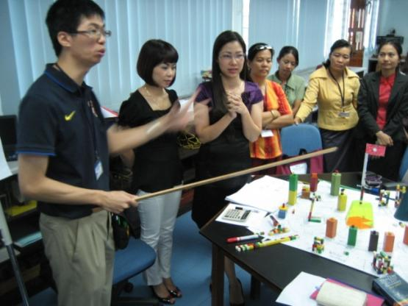
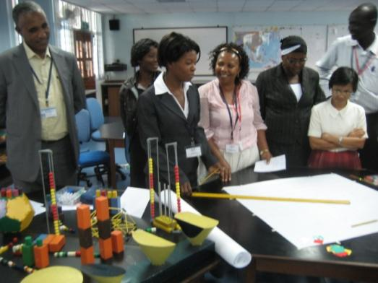
Scenario 2 – Presentation to dignitaries

Slide 14
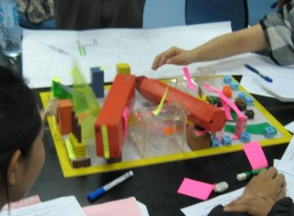
Scenario 4 – Instruct to Destruct
Consequences of inappropriate thoughts and values after much creativeness applied.

Slide 15
What have we learnt…
PBL4C, Cooperative and collaborative learning, & Education for Intranational and International Understanding (EIU)
PBL4C is a Learning in Context (Global Themes)
→Enhance cooperative spirit within a group, and collaborative spirit between groups
→Patriotism-nationalism and
international collaboration
→Education for Intranational & International Understanding (EIU)

Slide 16
What have we learnt…
Identifying & redefining values for creativity and sustaining entrepreneurship
Values are of 2 types:
constricted values – limited, restricted, pseudo - eg cooperative spirit, nationalism,
universal values – unbound, boundless, real - eg collaborative spirit, inter-nationalism
Any practice of value is good, but if it is not universal enough, then it is not good enough.

Slide 17
What have we learnt…
PBL4C, critical thinking and observation skills
In Scenario 3 – learners using Form 2
Practice Critical Thinking
A critical person criticises
Tends to look at weaknesses and faults
Looks at the half empty rather than the half full
The negative effects of Critical Thoughts can be known precisely using observation skills – looking within and without
Use introspection, self-reflection, meditation
Critiquing skills
More refined art of verbal, physical & mental actions
Building a more cultured civilisation

Slide 18
What have we learnt…
PBL4C, critical thinking and observation skills
In Scenario 3 – learners using Form 2
A critical thought created in the mind is the spark that leads to many conflicts among humanity
Nations promoting critical thinking as a Higher Order Thinking Skill (HOTS) needs to be careful of what you want for your fellow citizens…
Conflicts and wars start in the human mind
The best defense is to dose this spark as it arises right in the mind…

Slide 19
What have we learnt…
PBL4C, creative thinking and entrepreneurship
Problem-Based Learning the 4 Core Areas (PBL4C) enhances creative thinking
And thus opens wide the possibility of entrepreneurship
How?
It is learning about the world outside, realistically in the classroom
Learner Empowerment is practised
Mistakes made are not criticised
Risk takers can be trained
Practice to Expect the Unexpected
Creativity can be trained

Slide 20
What have we learnt…
Identifying & redefining values for creativity and sustaining entrepreneurship
Are values necessary for creativity and entrepreneurship?
Personal benefits and gains are ultimately the driving forces in creativity and entrepreneurship
Creativity and entrepreneurship can easily turn to become cunningness and dubious schemes if conscience and values are absent
Creativity and entrepreneurship can be sustained if guided by values
Values cater to the customers, clients or users of the creative enterprises

Slide 21
What have we learnt…
Identifying & redefining values for creativity and sustaining entrepreneurship
Are values necessary for creativity and entrepreneurship?
In free enterprises & free markets, user choices determine sustainability of any creative products or services; if there is no demand, supply ceases.
E.g.
Values integration enables reasonable profits, academic mathematics/business models teach maximising profits.
Which is more client- or user-centered?
Which is more sustainable?

Slide 22
What have we learnt…
Identifying & redefining values for creativity and sustaining entrepreneurship
Universal Harmonious Values :
Creativity and entrepreneurship should promote …
Making life easier
Moderation, not excessiveness - which is more sustainable
Seeks to fulfill needs rather than wants
Goodness, applying to all
Construction rather than destruction
Harmlessness, harmony & peacefulness

Slide 23
What have we learnt…
Identifying & redefining values for creativity and sustaining entrepreneurship
PBL4C can be used for any subject or discipline, place your emphasis on your subject area
Promotes the learning of any subject focusing on the 4 core areas :
multi-disciplinary content knowledge,
multi-dimensional skills,
appropriate thought, &
universal harmonious values.

Slide 24
Closing remark
Value without content knowledge is blindness.
Knowledge without value is dangerous.
Knowledge without skill is a disability.
Creativity is the start of new creations.
Creativity is also the end of old creations.

Slide 25
Q&A
Problem-Based Learning the 4 Core Areas (PBL4C): identifying & redefining values for nurturing creativity in building a new nation in Southeast Asia
Teoh Boon Tat, Warabhorn Preechaporn,
Leong Chee Kin & Fong Ho Kheong
Mathematics Education Specialists
SEAMEO RECSAM
Notes:
25

Slide 26
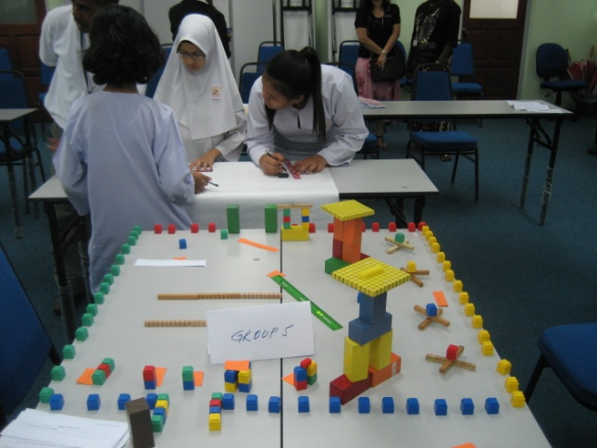
PBL4C in other contexts
Young Engineers Designing a Modern School – solar powered and equipped with a cineplex

Slide 27
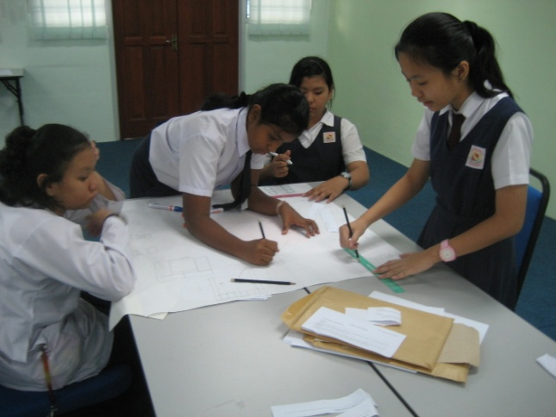
PBL4C in other contexts
Young architects at work as a team cooperatively

Slide 28
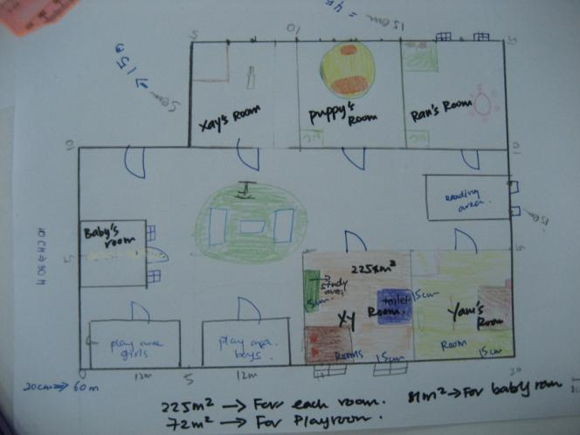
PBL4C in other contexts
Architects designing an accommodated and caring home layout

Slide 29
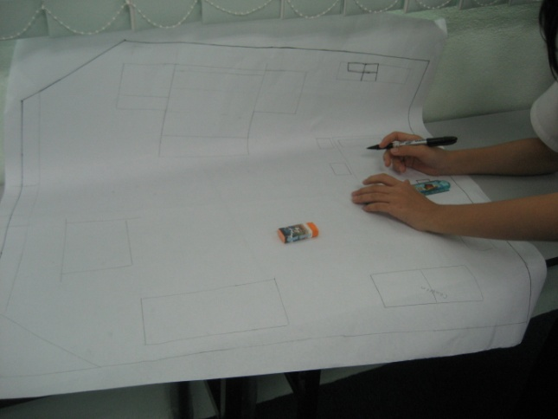
PBL4C in other contexts
Creating artists, interior designers, architects … in the classroom using PBL4C

