Slide 1
Uncovering Creativity and
Entrepreneurship in
Education Policy
8 December, 2011, Jakarta, Indonesia
Director. Dr. Seung-Bo Kim
Center for Career Development
Korea Research Institute for
Vocational Education & Training
sbkim@krivet.re.kr
Notes:
15th UNESTCO-APEID International Conference
Education for Creativity Entrepreneurship

Slide 2
Why is Creativity
Important in Korea?
Notes:
15th UNESTCO-APEID International Conference
Education for Creativity Entrepreneurship

Slide 3
Why is creativity important ?
“…economic growth that is based on expansion of inputs,
rather than on growth in output per unit of input,
is inevitable subject to diminishing returns.”
(“The Myth of Asia’s Miracle” by Paul Krugman, Foreign Affairs vol.73 in 1994)
< Analysis on growth rate of output & contributing factors
by industries (‘81-‘05) >
Nation | Gross Out | Labor Input | Capital Input | Energy Input | Material Input | Service Input | TFP
Korea | 7.74 | 0.64 | 1.91 | 0.48 | 3.08 | 1.44 | 0.20
United State | 2.76 | 0.56 | 0.72 | - 0.04 | 0.45 | 0.67 | 0.40
Japan | 2.32 | 0.06 | 0.93 | 0.04 | 0.53 | 0.58 | 0.17
EU(10) | 2.37 | 0.21 | 0.54 | 0.03 | 0.53 | 0.73 | 0.34
Source: Korea Productivity Center(2009).
Reconstruction on “International comparison of TFP”
Notes:
☞ 폴 크루거만
“한국의 성장은 요소생산성의 향상(기술혁신)에 의해서가 아니라
요소투입량(노동과 설비 등)의 증가에 의한 것...... 요소투입량은
무한정 늘릴 수 없기 때문에 성장도 곧 한계에 이를 것”
(1994년, The Myth of Asia’s Miracle, Foreign Affairs vol.73)
* 전산업의 산출증가율과 기여요인 분석(‘81-’05)
- 자료: 한국생상선본부(2009). ‘총요소생산석의 국제비교’ 재구성
* TFP (Total Factor Productivity)

Slide 4
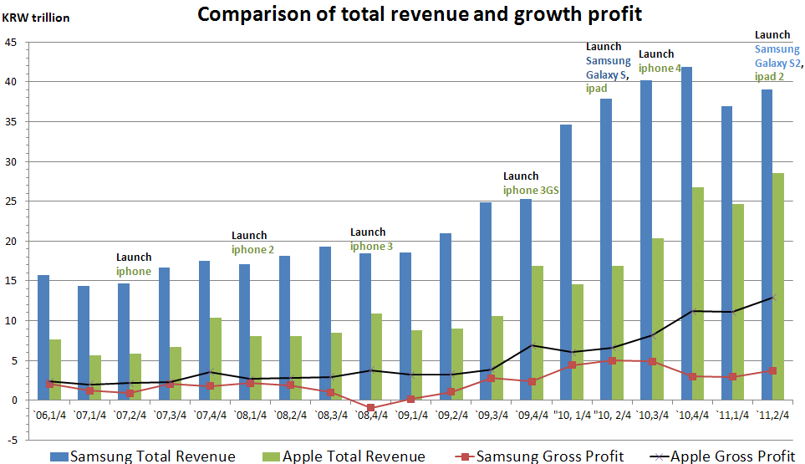
Notes:
Comparison of total revenue and growth profit
4

Slide 5
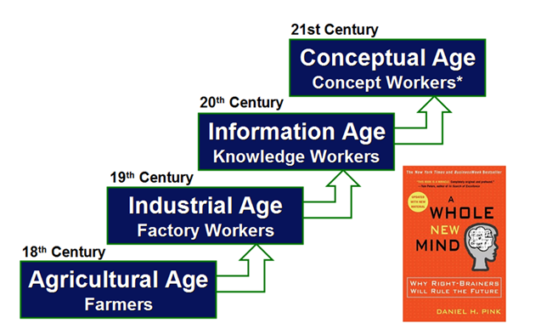
Why is creativity important ?
Source: Daniel H. Pink(2005). A Whole New Mind: Moving from the Information Age
to Conceptual Age.
Notes:
In his book, A WHOLE NEW MIND, Daniel Pink describes boundary crossers as individuals who “develop expertise in multiple spheres…and find joy in the rich variety of human experience. They live multi lives—because that’s more interesting, and ….more effective….
Boundary crossers reject either/or choices and seek multiple options and blended solutions. They lead a hyphenated life filled with hyphenated jobs and enlivened by hyphenated identities.”
Create a "slash" life that includes more than one area. Look to one area for steady income (e.g., software developer) and add on a freelance or volunteer role in a second area (e.g., professional musician.)
The different outlets can help you create a customized career. The book, One Person/Multiple Careers: A New Model for Work/Life Success has some great examples of people who have done this.
* 새로운 성장 패러다임을 위한 ‘창의적 인재’ 의 요구
- 전 세계적으로 ‘창의성’에 바탕을 둔 새로운 경제 패러다임 부상
- ‘창의적 인재’ 육성에 대한 사회적 관심 증대.

Slide 6
Why is creativity important ?
< Employees wanted by Top 100 businesses >
 | Creativity | Expertise | Daring spirit | Morality | Teamwork
Top 100 Companies | 71.0 | 65.0 | 59.0 | 52.0 | 43.0
 | Globalized ability | Earnestness | Ownership | Execution
Top 100 Companies | 41.0 | 29.0 | 13.0 | 10.0
Source: Korea Chamber of Commerce & industry (2008).
“A report on employees wanted by Top 100 businesses”.
Notes:
According to a survey concerning employees wanted by businesses recently carried out by the Korea Chamber of Commerce and Industry (KCCI) of the country’s Top 100 businesses (in terms of sales), the responding businesses pointed to: “Creativity” (71%), “Expertise” (65.0%), “Daring spirit” (59.0%), “Morality” (52.0%), “Teamwork” (43.0%), “Globalized ability” (41.0%), and “Earnestness” (29.0%).
Those pointing to creativity as the most important virtue wanted from their employees said that it was becoming a core factor of corporate competitiveness to meet rapidly changing requirements of customers through the creation of new values.
The KCCI report also said that it appeared that businesses wanted their employees to be equipped with expertise in step with the progress in technologies being segmented and sophisticated as well as the daring spirit required to lead changes and innovations in a management environment.
By type of business, those engaged in financial/insurance and manufacturing pointed to “Creativity” (79.2% and 70.6%), while wholesale/retail and transportation businesses to “Expertise” (83.3% and 80.0%) and construction businesses to “Daring spirit” (75.0%) as the most important virtues they wanted from their employees.
Concerning “Expertise” pointed to by those engaged in wholesale/retail and transportation, the report attributed it to the badly felt need to be a world-class business amid the fierce competition with distributors and transportation businesses the world over.
Commenting on the survey, a KCCI official said, “The virtues, such as creativity, expertise and a daring spirit, are what most businesses want from their employees. The country’s school education needs to train and educate young folks in a way that can meet businesses’ requirements in these areas.
CALLS FOR GREATER CREATIVITY
AND INNOVATION
The growth of the global economy has
added urgency to calls to upgrade education
and training as prime sources of national
economic competitiveness.

Slide 7
2. Major Issues in the
Education Policy
for Creativity
Notes:
15th UNESTCO-APEID International Conference
Education for Creativity Entrepreneurship

Slide 8
Major Issues in the Education Policy for Creativity in Korea
< Effects of economic growth by education fever>
Nation | Education fever | Effects of economic growth by education fever | Nation | Education fever | Effects of economic growth by education fever
Poland | 3.2 | 0.93 | Switzerland | - 0.1 | - 0.02
New Zealand | 2.3 | 0.67 | Denmark | - 0.1 | - 0.03
Korea, Rep. | 2.3 | 0.65 | United Kingdom | - 0.4 | - 0.12
Hungary | 2.0 | 0.59 | Mexico | - 0.5 | - 0.13
Canada | 1.8 | 0.51 | Netherlands | - 0.5 | - 0.13
United States | 1.8 | 0.51 | Ireland | - 0.7 | - 0.20
Sweden | 1.4 | 0.40 | Belgium | - 0.9 | - 0.25
Norway | 1.1 | 0.32 | Japan | - 0.9 | - 0.27
Australia | 1.1 | 0.32 | Austria | - 0.9 | - 0.27
Finland | 0.5 | 0.14 | France | - 1.2 | - 0.35
Greece | 0.4 | 0.10 | Turkey | - 1.3 | - 0.36
Germany | 0.1 | 0.03
Source: Kim, Tae-jong(2007). “An empirical study for economic valuation by education
fever ”. Presidential Committee on education Innovation.
Notes:
Recently, Obama has publicly praised the achievements of the South Korean public education system.

Slide 9
Major Issues in the Education Policy for Creativity in Korea
< Average study time per hour & score (Science+Math+Reading) >
Nation | Curricular hour | Extracurricular hour | Self-study hour | Total Study hour | Total Score | Score Per hour
Netherland | 8 | 1.8 | 4 | 13.8 | 1562.3 | 113.2
Korea | 12.8 | 7.1 | 4.9 | 24.8 | 1625.6 | 65.5
OECD average | 10.6 | 2.4 | 4.9 | 17.9 | 1489.5 | 83.2
Source: Korea Employment Information Service(2009).
< Sleep time and exercise time (15 to 24 years old) >
(Unit: hour:minute)
Time | Korea | United State | England | German | Sweden | Finland
Sleep | 7:30 | 8:47 | 8:36 | 8:06 | 8:26 | 8:31
Exercise | 0:13 | 0:37 | 0:13 | 0:24 | 0:26 | 0:22
Source: BLS & ATUS(2004), EUROSAT & HETUS(2005). “Time Use Survey”
Notes:
* 선발의 편리성과 효율에 초점을 맞춘 입시제도
- 국가별 주당 평균 학습시간, 점수 및 시간당 점수
- 각국의 수면시간 및 운동시간 비교(15세-24세)

Slide 10
Major Issues in the Education Policy for Creativity in Korea
< Rank of math score & math score per hour(PISA in 2006) >
Nation | Math Score |  |  | Math Score per hour
 | Rank | Average | Standard Deviation | Rank | Average | Standard Deviation
Chinese Taipei | 1 | 563 | 95 | 7 | 138 | 123
Hong Kong-China | 2 | 551 | 88 | 2 | 151 | 141
Finland | 3 | 549 | 76 | 5 | 139 | 88
Korea | 4 | 547 | 89 | 48 | 99 | 80
Netherlands | 5 | 537 | 84 | 9 | 135 | 90
CzechRepublic | 6 | 536 | 104 | 12 | 128 | 94
Switzerland | 7 | 528 | 91 | 18 | 123 | 99
Belgium | 8 | 527 | 98 | 6 | 138 | 115
Japan | 9 | 526 | 86 | 8 | 135 | 111
Liechtenstein | 10 | 525 | 89 | 13 | 128 | 97
Notes:
* 선발의 편리성과 효율에 초점을 맞춘 입시제도
- 국가별 주당 평균 학습시간, 점수 및 시간당 점수
- 각국의 수면시간 및 운동시간 비교(15세-24세)

Slide 11
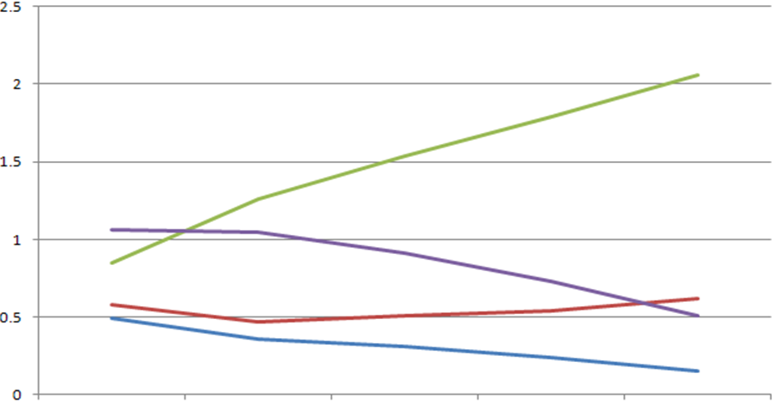
Major Issues in the Education Policy for Creativity in Korea
< Private tutoring hour in Korea according to PISA (Math) >
(Unit: Hour / Level )
Korea
Japan
United
State
Finland
Level 1
Level 2
Level 3
Level 4
Level 5
Source: Park, So-young(2009). “Analysis on political direction of PISA 2006” .
Korean Educational Development Institute.

Slide 12
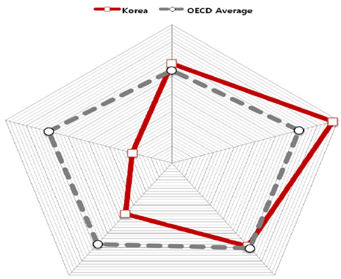
Financial
Vitality
Financial
Sustainability
National
Happiness
< Welfare Index
(KCWA) 2011
Welfare
Satisfaction
Welfare
Supply
 | Total | Financial Vitality | Financial Sustainability | Welfare Satisfaction | Welfare Satisfaction | National Happiness
OECD Average | 0.586 | 0.535 | 0.612 | 0.608 | 0.578 | 0.593
Korea | 0.499(26) | 0.575(12) | 0.775(4) | 0.593(17) | 0.363(28) | 0.190(29)
Source: Kim, Young-ha., et al(2011). “A Comparative study on Welfare Index of OECD
Countries: KCWA(KIHASA-Chosun Welfare Index 2011)”.
Korea Institute for Health and Social Affairs.
Notes:
종합지수 OECD 30개국 중 26위 국민행복지표 29위…재정은 양호
KCWI 2011 종합복지지수
○ 5개 지표를 종합한 최종순위는 26위로, 종합 평균은 0.499점임.
○ 재정지속지표와 경제활력지표만 OECD 평균을 상회하였으며, 복지수요지표, 복지
충족지표, 국민행복지표는 OECD 평균보다 낮음.
－ 특히 국민행복지표(0.190점, 29위)와 복지충족지표(0.363점, 28위)는 평균과의
격차가 크게 나타나 가장 취약함.
○ 한국은 지표간 불균형이 심하게 나타나고 있는데, 경제적‧재정적인인 측면에서는
일정 부분 성과가 나타나고 있으나, 특히 복지충족도와 국민행복도가 매우 낮아 복
지제도가 원활히 그 역할을 수행하고 있지 못한다고 판단됨.
o 우리나라 성인들의 낮은 삶의 만족도
- 국가별 삶의 만족도 및 직무만족도 비교에서 삶의 만족도 및 직무 만족도가 낮게 나타남. ‘2006 (경제협력개발기구)OECD 국가별 행복지수 종합순위’에서 한국인의 행복지수는 30개 회원 국가 중 25위에 그친 것으로 나타남.

Slide 13
3. The Education Policy
for Creativity in Schools
Notes:
15th UNESTCO-APEID International Conference
Education for Creativity Entrepreneurship

Slide 14
The Education Policy for Creativity in Schools
Revise school curriculum focusing on improving core competence
< Textbooks: From rote-based learning toward practice-based learning >
Curriculum | Direction
Korean | Strengthen writing skills and integrated language ability
Mathematics | Heighten reasoning and problem-solving skills
Science | Develop scientific skills and knowledge linked with everyday life Improve comprehensive educational approach that integrates art with STEM
English | Strengthen speaking & listening-centered communicative competence
Social · Moral Studies | Worldview · national identity · occupational view Theme-centered integrated education
Sports · Arts | Physical activities & expression-centered
Notes:
14
* 핵심역량 중심의 교과 교육과정 개정
교과서는 이론 요약 중심에서 현장·실생활 중심으로 개선
교과: 교과 교육과정 개편 방향
국어: 글쓰기 교육 강화, 통합적 언어사용능력강화
수학: 논리력, 문제해결 과정 중심으로 개편
과학: 실험탐구활동 강화, 공통교육과정은 융합방식으로 개선
영어: 말하기, 듣기 중심의 의사소통능력 강화
사회, 도덕: 세계관, 국가관, 직업관, 주제 중심 통합교육
체육, 예술: 신체활동, 표현중심으로 개편

Slide 15
The Education Policy for Creativity in Schools
Introduce Creative Hands-on Activities
Comprehensive
Student Support
Service (Edupot)
->“Club activities,
career activities, and
community services”
are systematically recorded,
so that these can be
referred when they entering
higher grade.
Introducing
Creative Hands-on
Activities
-> Allotting
for 3~4 hours per week
classes in primary and
secondary schools
Setting up a system
to support creative
hand-on experience
-> Encouraging industries,
government- funded
institutions, and universities
to provide human resources,
and facilities
Notes:
창의적 체험활동의 도입
- 초등학교에서 고등학교까지 주당 3~4시간 수업 시수 배정
창의적 체험활동 종합지원 시스템(Edupot)
- 동아리, 봉사, 진로 활동 등 실적을 체계적으로 기록, 관리 및 상급학교 진학에 활용
창의적 체험활동 활성화를 위한 지원체계
- 기업, 출연(연), 대학의 인력, 시설, 장비를 활용하는 교육기부 확산
15

Slide 16
The Education Policy for Creativity in Schools
Reinforce career and academic education & school grading system to upgrade the level of classes
A more comprehensive grading system to evaluate narrative responses (To better assess problem-solving ability and critical thinking)
Improve the relative evaluation system that has been stratifying students into 9 levels in a school report
Increase the number of career and academic counselors in schools.
Notes:
Enforce the training for teachers, to enable them to better guide students by their own individual characteristics, and to enable them to provide better counseling for college entrance exam.
* 수업변화를 지원하는 내신평가 및 진로진학교육 강화
서술형 평가의 안정적 확대 지원(문제해결력·비판력 측정),
수업시간을 활용한 결과와 과정이 조화된 수행평가
학교생활기록부의 상대 9등급 개선 추진
진로진학상담교사 확대
- 진로진학교육(상급학교 진학, 미래 직업탐색 등) 내실화
- 일반교사가 담당교과 수업에 더 집중할 수 있는 여건 조성
* 학생 맞춤형 지도가 가능하도록 진로진학지도, 입시상담 등 현장 중심 연수 강화
16

Slide 17
The Education Policy for Creativity in Schools
Establish democratic education focused on experience and practice
Encourage students to take leadership in school events and club activities
Make use of resources and programs provided by government agencies
Establish infrastructure to discover creativity and career paths for students from multicultural families and underachievement students
Notes:
* 체험과 실천 중심의 민주시민교육 활성화
학생주도의 학교행사 및 동아리 활동 활성화
- 학교행사(졸업식·입학식, 축제, 발표회 등)를 학생 중심으로 추진
- 참여형 학습방법 확대(토론학습, 협동학습, 그룹프로젝트 등)
- 다양한 민주시민교육의 기회 활용(학급회의·학생회 참여·토론)
정부부처들이 제공하는 다양한 자원과 프로그램을 활용
- 학생자치법정 등(such as “Teen Court”)
- 민주시민교육실시(교육과정 및 학교생활과 연계된 체험중심)
17

Slide 18
The Education Policy for Creativity in Schools
Vitalize career education in primary and secondary schools
Strengthen career education
Elementary
Search talents · aptitudes (Understand career · job market)
Middle
Search career · job market (Select high school)
High
Select career · job (Select work· department/university)
Bolster career education in school curriculum, so that it better bridges with the curriculum, career, and the future job
‘Career and Job’, A pilot program of ‘Career Zone’ for the departmentalized classroom system
Notes:
* 초·중등 단계에서의 진로교육 활성화
진로교육 강화 : 소질과 적성 탐색, 상급학교 진학, 직업선택
교과 · 진로 · 직업이 상호 연계될 수 있도록 ‘교과 속 진로수업’ 강화 (
‘진로와 직업’ 교과 교실제를 위한 커리어존 시범 운영 등
초등학교: 소질, 적성 탐색 (진로, 직업 세계 이해)
중학교: 진로, 직업 탐색(고교 선택)
고등학교: 진로 및 직업 선택(직장, 학과/대학 선택)
18

