Slide 1
Introduction to ITIL
Notes:
Learning Objectives
Understand the growing need for better project management, especially for information technology projects.
Explain what a project is, provide examples of information technology projects, list various attributes of projects, and describe the triple constraint of projects.
Describe project management and discuss key elements of the project management framework, including project stakeholders, the project management knowledge areas, common tools and techniques, and project success factors.
Understand the role of the project manager by describing what project managers do, what skills they need, and what the career field is like for information technology project managers.
Describe the project management profession, including its history, the role of professional organizations such as the Project Management Institute, the importance of certification and ethics, and the growth of project management software.

Slide 2
IT Service Delivery & Support

Slide 3
What is IT Service Management?
The management of IT services to support one or more business areas
A set of process and procedures aimed at the provision of high quality, cost effective IT Services –Driven by business dependency upon IT
The best definition and independent guidelines for IT Service Management can be found in ITIL

Slide 4
IT is the business……….
“IT is the business”
and
“The business is IT”

Slide 5
The Four Ps
IT Service Management (ITSM) is all about the efficient, effective and economical use of:
People
Customers, Users & IT Staff
Processes
ITIL
Products
Tools and technology
Partners
Vendors and Suppliers

Slide 6
The Drivers for High Quality IT Services
Organizations increasingly dependent on IT service provision
Higher visibility of failure
More exacting User requirements
Increased complexity of the infrastructure
Charging for IT services
Competition for Customers
Legislative/regulatory drivers

Slide 7
ITIL Philosophy
Capture industry “best practice”
Organizations should adopt and adapt
Not standard! (however)
ISO/IEC 20000
Scalable —organization size and need
Platform independent
Originally intended for UK Government use only, but….
By 2006 more than 250,000 books sold worldwide, majority outside UK and Government
itSMF
Around 40 international chapters

Slide 8
IT Infrastructure Library (ITIL)
The Business
Planning to Implement Service Management
The Technology
The
Business
Perspective
Service Management
ICT
Infrastructure
Management
Service
Support
Service
Delivery
Security
Management
Application
Management

Slide 9
Best Practice A Working Definition
Best Practice is a set of guidelines based on the best experiences of the most qualified and experienced professionals in a particular field. Best Practice is based on:
More than one person
More than one organization
More than one technology
More than one event

Slide 10
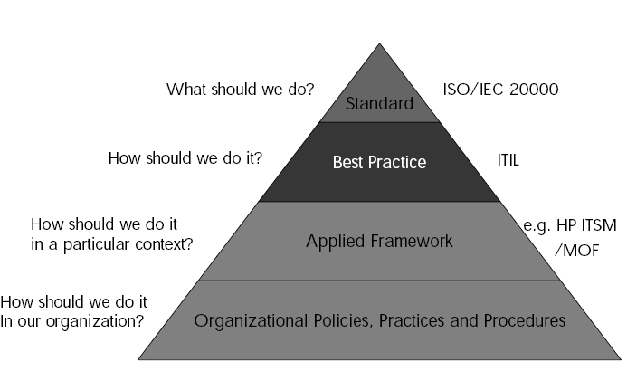
Where Does Best Practice Fit?

Slide 11
ITIL Objectives
Reduce Costs
Improve Availability
Tune Capacity
Increase Throughput
Optimize resource Utilization
Improve Scalability

Slide 12
The Advantage of ITIL
Neutral
Comprehensive
Modular
Quality Approach
Cost-effective
Universally applicable
Supporting tools available

Slide 13
Who Is Doing This?
Government
Financial services
Insurance
Manufacturing
Publishing
Outsourcing companies
Utilities

Slide 14
Management of Expectations (1 of 3)
When implementing ITIL it is vital to manage the expectations of the organization in terms of
Deliverables
Timescales
Changes to the Organization's Roles and Responsibilities
Savings

Slide 15
Management of Expectations (2 of 3)
Deliverables
Set out what you want to achieve (i.e. have a Goal)
Build “Achievements” rather than “Everything in One Go”
Timescales
Be realistic, most processes require 18-24 months for full effectiveness/savings to be achieved, i.e. the processes mature
Set out a timeline of what you want to have achieved, by when

Slide 16
Management of Expectations (3 of 3)
Roles & Responsibilities
ITIL emphasizes “Roles” not Managerial positions, i.e. you do not necessarily need to recruit a whole new batch of people
ITIL will change peoples jobs and roles, make sure this is managed, and doesn’t occur as just as an offshoot.
Savings
You may need to initially increase your costs i.e. “speculate to accumulate”
Be aware that the saving may not be experienced at the point of cost, but at another point in the process/organization
Increased IT expenditure may be required to deliver Business benefits (e.g. increased profit margins, decreased turn around times, faster times to market etc)

Slide 17
The “Way Forward”
ITIL is “Adopt and Adapt” so is not prescriptive about which process to implement first.
It is also not prescriptive about how you should design your organization or what tools you should use.
All about “What is best, and makes most sense for your organization”.

Slide 18
However….
Look for quick wins
Look for processes that can be introduced together as a package (e.g. Configuration and Change)
You don’t need to complete one before starting another, “build” them a stage at a time (e.g. start small and expand coverage /depth)
Use your existing staff wisely, and you probably don’t need to radically increase your head count, in fact you may reduce it over time
If at first you don’t succeed –DON’T give up!
AND don’t run before you can walk!

Slide 19
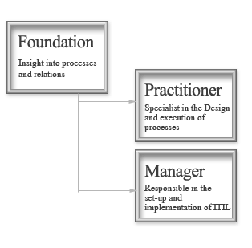
ITIL Certification
The Foundation Certificate enables people to understand the terminology used within ITIL. It focuses on foundation knowledge with regard to the ITIL Service Support and Service Delivery sets as well as generic ITIL philosophy and background. It is a prerequisite for the Practitioner's and Manager's Certificates in IT Service Management.
The Practitioner Certificate focuses upon the understanding and application of the specific processes within the IT Service Management discipline.
The Manager's Certificate is aimed at experienced professionals, who will be involved in managing service management functions.

Slide 20
Function, Process, Procedure

Slide 21
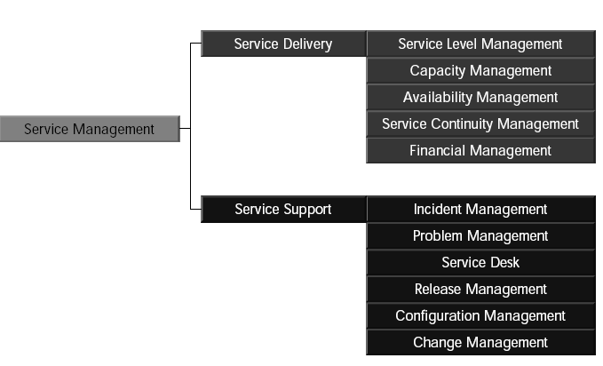
Core ITSM Components

Slide 22
Service Support
These are the more “Day to Day” processes which supports Service Management
Typically tend to be more “Reactive” than “Proactive”
Made up of 5 Processes and 1 Function
Service Desk (Function)
Incident Management
Problem Management
Configuration Management
Change Management
Release Management

Slide 23
Service Delivery
These are the more longer term planning type processes which supports Service Management
Typically tend to be more “Proactive” than “Reactive”
Made up of 5 Processes
Service Level Management
IT Service Continuity Management
Finance for IT Management
Availability Management
Capacity Management

Slide 24
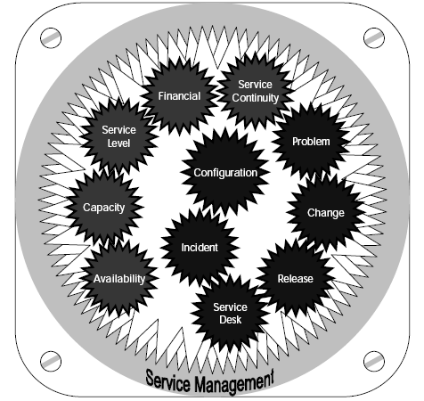
Service Management

Slide 25
Function vs Process vs Procedure
The Service desk is a FUNCTION consisting of analysis, the service desk manager & other stakeholders, who follow a set of PROCESSES which are documented in a PROCEDURE manual.
A process defines what is to be achieved.
Procedures define how the objectives are to be achieved.

Slide 26
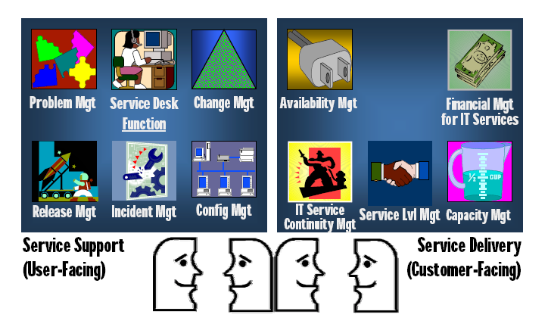

Slide 27
Cultural Aspects & Excellence in Customer Service

Slide 28
Cultural Aspects & Excellence in Customer Service
Customers & consumers
Process improvement
Management commitment
What is culture?
What is service culture?
What is customer service?
Customer profiling?

Slide 29
Customers & Consumers
A customer is a recipient of a service - someone who deals with trader & habitually purchases from them
A user, in ITIL terms, is the person using the service on daily basis
So what is a consumer?
Traditional perception of customers by IT
The way in which service is delivered is dependent on the people delivering the service

Slide 30
What do customers want from IT? (Back to Basic)‏
Services are available when THEY need them
Value for money
Services are Business Aligned
Their expectations are better managed
To be kept informed
Confidence in IT’s ability to deliver
A single point of contact & communication

Slide 31
What do IT Manager’s want?
To deliver a professional, stable & consistently improved service to the business
To demonstrate accountability & value for money
To build a flexible & scalable service department they & their team are proud of

Slide 32
Process Improvement
Service Management implementation is a process improvement
The objective of process improvement is to improve the service
A Service Improvement Program (SIP) is an ongoing initiatives

Slide 33
Process Improvement Stages
Process improvement definition
Defining the mission statement
Setting goals & objectives
Communication
Raising the awareness
Planning
Design, produce, & identity plans, training & resources
Complete a cost/benefit analysis
Implementation
Develop, implement, train, produce, test & measure
Review & Audit

Slide 34
Continuous Service Improvement Program
What is Vision?
High level business
objectives
Where are we now?
Assessments
How do we check
our milestone have
been reached
Where do we want to
Be?
Measurable targets
How do we get to
Where we want to be?
Process Improvement
How do we check our
Milestone have been
Reached?
Measurements and
Metrics

Slide 35
Management Commitment
Motivating & leading by example
Authority given to required decision makers
Sponsor & ITSM “champion” assigned
Training
Big picture & long term strategic solution
Realistic implementation timetable
Appropriate tools to support the process
Under Project Management

Slide 36
A customer is the most important visitor on our premises. He is not dependent on us. We are dependent on him. He is not an interruption of our work. He is the purpose of it. He is not an outsider to our business. He is part of it. We are not doing him a favour by serving him. He is doing us a favour by giving us the opportunity to do so.
Mahatma Gandhi

Slide 37
Service Culture
A culture is value and beliefs of organization
A service culture means orientation towards helping people
“people don’t care how much you know until they know how much you care”

Slide 38
Customer Service
Customer service is..
providing the right quality of services to meet the customer’s requirement
help customers make best use of these services
being receptive to customer’s needs and problems and provide them with effective support at all time
Tools: Customer profiling

